Slide 1

String Formatting &
Types of Errors
Notes:
This is lesson 2 in Week 2 of the Programming I module. Today, we will cover two topics. First, we will go into some of the nitty gritty details of strings, and how we can control how strings are displayed on screen. We will then talk about the different types of errors you might encounter as you are writing your programs, and what are some ways you can use this information to help you correct your program (also known as “debugging”).

Slide 2
Objectives
At the end of this lesson, you will learn about….
Escape Sequences
String Formatting
Types of Errors
Notes:
We will first examine strings more closely. In particular, we will talk about something called escape sequences, followed by different ways you can format your strings. In the second part of this lesson, we will discuss different types of errors, such as syntax errors, logical errors and so on, and what you can do about them.

Slide 3
Escape Sequences
Notes:
So let’s talk about escape sequences. You already know the basics about strings in the last lesson. In general, whatever you type on the screen and enclose in quotes is a string in Python. And some of you may have already figured out that one of the reasons Python allows both single and double quotes is because if you want to print a string that includes a single quote, you can just enclose it in double quotes, and vice versa.
But what about some of the weirder characters, like tab and enter? Or what if you want to have a string that contains both single and double quotes? That’s where escape sequences come in.

Slide 4
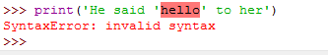
Escape Sequence
Consider the case where literal quotes ' ' are part of a string. A syntax error will be produced.
To help us ‘escape’ single quotes or double quotes, a backslash \ can be inserted.
The backslash character together with the single quote form an escape sequence.
Notes:
Let’s say we need to print a pair of single quotes as part of a string. If you enclose the string within single quotes, you will get an error. What happens is that Python will go through the statement and assume that ‘He said ‘ is the string because it is enclosed in a pair of single quotes. It will then see the h in hello and say, hey, that’s not right and freak our with a SyntaxError.
To avoid this, put in a backslash before each single quote in the string, like this. The backslash in a string is a special character that tells Python “the next character after the backslash should be treated literally.”
The backslash together with the single quote form an escape sequence, because it helps the character escape from the quotes.
Pop quiz: what do you do if you want to have the backslash character as part of your string?

Slide 5
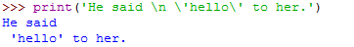
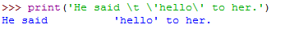
Escape Sequence
There are other escape sequences. Two commonly used escape sequences are:
\n ↵ new line
\t ⇥ tab stop
Refer to: https://docs.python.org/3/reference/lexical_analysis.html
2.4.1. String and Bytes literals for full list of escape sequences.
Notes:
There are quite a few other escape sequences, two of the most commonly used are newline, which is backslah-n, and tab stop, which is backslash-t. New line continues the next character in the next line, so this statement produces this output over two lines. Tab stop is like what happens when you hit Tab in Microsoft Word or IDLE, in that it will leave spaces until the next tab stop location. You can follow this link to see a full list of Python string escape sequences.

Slide 6
String Formatting
Notes:
Right, so your basic strings are pretty straightforward, but quite often, you want to create a string that is made of many different parts, and you can substitute the correct value for each part as needed. Here’s how Python helps you do that.

Slide 7
String Formatting
Python provides 2 ways to do String Formatting – allowing multiple substitutions in a string
Using string formatting operator %
%s are placeholders to be replaced by the arguments.
Using string formatting method call format()
{ } in original string are placeholders to be replaced by respective arguments.
2nd method is the preferred standard in Python 3 (https://docs.python.org/2/library/stdtypes.html#str.format)
'…%s…'% (arguments)
'…{}…'.format(arguments)
Notes:
Python provides 2 ways to do String Formatting, which allows multiple substitutions in a string
The first way uses a percent sign, and inside the string there are special characters called placeholders that indicate what kind of argument is going in, so %s says it’s a string, %d says it’s a decimal value, and so on. This is similar to how some of the older programming languages like C and C++ do string formatting, so if you are familiar with those languages, this type of string formatting will be familiar to you.
The second way, which is considered the preferred way to do string formatting in the latest versions of Python, is to use the format method. Instead of explicit placeholder, it just used sets of braces (which are those curly brackets). Since we are a hip, modern, forward-thinking school, we will teach you the format method, because it’s dope. It’s lit. It’s sick. Yeah this is getting cringe. Let’s move on.

Slide 8
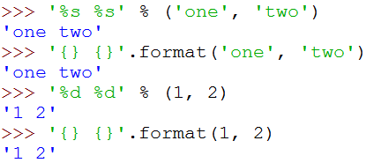
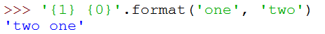
String Formatting
Basic Formatting
format() method allows rearrangement in output without changing order of arguments:
Notes:
The format method is a function that is used for strings, so what you do is write a string as usual in single or double quotes. Inside the string, you can put multiple pairs of braces indicating where you want to insert your arguments. You then write .format after the string, followed by your arguments in brackets. In this example, there are two pairs of braces inside the string, and there are two arguments given in the format function, which are the strings ‘one’ and ‘two’. This is produces the string ‘one two’.
The cool thing about the format method is that it is smart enough to convert your arguments into strings for you, so this line where the arguments are integers produces the expected result of a string containing the numbers ‘1 2’.
One functionality provided by the format() method is to allow you to rearrange the output without changing the order of the arguments, by putting the argument numbers inside the braces. Take note that the first argument is argument zero, not argument 1. In this example, we will get the string ‘two one’. And in this example created by some crazy programmer, you see that you can mix the arguments up however you want.

Slide 9
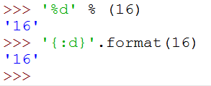
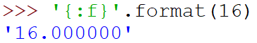
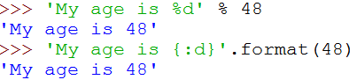
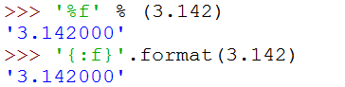
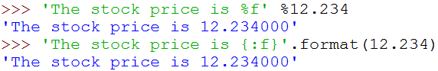
String Formatting
Integers
Floating Point
Notes:
When you are formatting strings with numbers, you sometimes want to tell Python explicitly how to treat the arguments. To specify the argument as an integer, you use ‘:d’, where the d stands for “decimal number”. So these statement produce these results.
To specify the argument as a float, you use ‘:f’, which stands for floating point number. By default, Python will print floats up to 6 decimal points, which is why you get these results.
Why is this important? Depending on what you specify in the formatting string, Python will treat the same argument differently. For example, specifying that 16 is a float instead of an integer results in the addition of a decimal point and 6 zeros at the end. What if I specify 3.142 as a decimal? Try it out and see. Spoiler alert: it crashes.

Slide 10
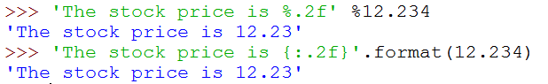
String Formatting
The default is to have six decimal points of precision for float.
The precision can be changed as follows:
Notes:
Like I said, the default for floats is to have six decimal points of precision. If you want to change the precision, put a dot followed by the number of precision places in between the colon and the f, so this code, which specifies 2 decimal places, changes 12.234 into 12.23.

Slide 11
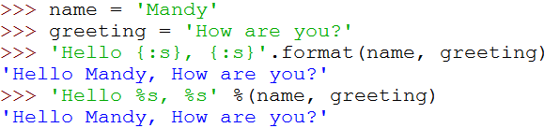
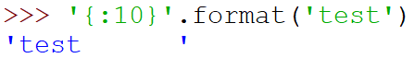
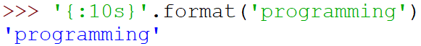
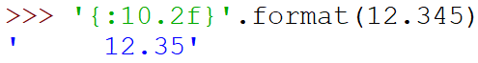
String Formatting
Strings
Padding and Alignment
By default, values will take up as many characters as needed
possible to pad a value to a certain length.
format() defaults alignment to left for strings.
Note: alignment to right for other types
Notes:
Now, let’s examine string arguments a bit more closely. To explicitly tell Python that an argument is a string, you can use ‘:s’, although this is usually unnecessary because that’s the default for the format method. The argument will take up as many characters as needed. However, it is possible to pad a value so that it takes up a certain number of characters, which can be useful for presenting information is a neat, tabular manner.
To add padding, the simplest way is to put the total number of spaces after the colon, so this statement gives us the string ‘test’ with 6 spaces to the right. For strings, the default alignment is to the left, but for other types it is to the right. So this, statement, which says to convert 12.345 into a string that takes up a total of 10 spaces and round it to 2 decimal places, produces the string ‘12.35’ with 5 spaces to the left. Note that the 10 is the number of spaces taken up by the entire string, not just the part before the decimal point.
Incidentally, if the number of spaces specified is too few to display the entire argument, it will show the entire argument anyway. Python won’t cut the argument down to size for you.

Slide 12
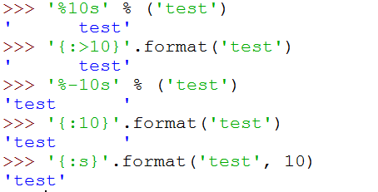
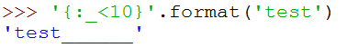
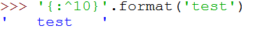
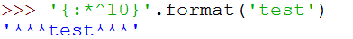
String Formatting
format() allows using < , > or ^ to denote direction of alignment
format() allows choosing of character to do the padding:
Notes:
Remember that the default alignment for strings is left-justified? You can specify the direction of alignment using the less than, greater than or caret signs. Caret is shift-6 on your keyboard. These represent left, right and centre alignment, respectively. You put these alignment characters immediately after the colon, so this statement says to right-align the string ‘test’ into 10 characters, producing this result.
Not only that, you can choose the character to do the padding. By default it’s a space, but you can specify any single character. Take a look at these examples of using different padding characters and different alignments.
This is so neat, if you are a complete nerd like me.

Slide 13
String Formatting
format() makes use of a format instruction called Format Specifier
argument position
alignment
{2:<9.2f}
Format type
precision
number of spaces
Placeholder symbol
Notes:
OK, now that we have seen some examples, let’s break down the various components of all the stuff we can put into those braces, which is actually called a format specifier. Given this specifier, the pair of braces together form the placeholder symbol. Next comes the argument position, so this 2 says that it is actually the third argument in the format argument list. The colon separates the next symbol, which is the alignment, whether it is left, right or centre-aligned. After that you have the number of spaces that the entire string will take up. The letter at the end denotes the format type. In this case it is a float, which also allows you to have a dot followed by another number specifying the precision (i.e., the number of decimal places).
Yeah, it’s quite a bit to take in all at once, but take your time and play around with it. It’s a pretty powerful function that gives you lots of ways to control your string formatting.

Slide 14
String Formatting
Commonly used Format Types:
Format type | Description
s | string
c | character
d | decimal (base 10) integer
o | octal integer
x | hex integer
X | same as x, but uppercase
f | floating point real numbers
e | exponent notation
Notes:
Along with s, d and f, here are some of the commonly used format types. c represents a single character. When you learn numbers in base 8 and base 16, you can use o and x for them, respectively. And if you remember your scientific notation for decimal point numbers, like 2.735 * 10 to the power of negative 3, that’s what the exponent notation e is doing.

Slide 15
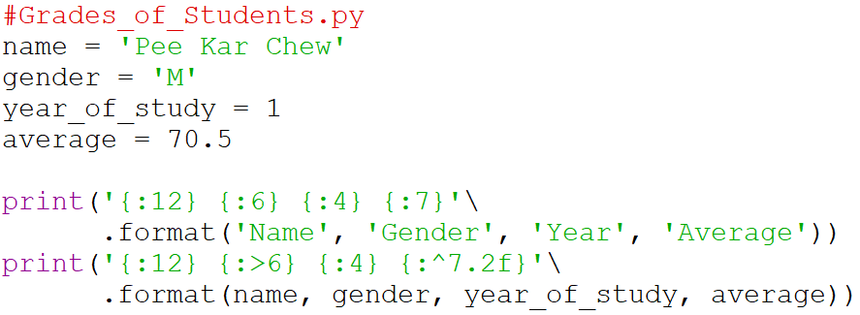
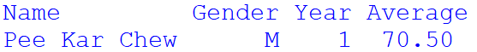
String Formatting
Application:
Output:
Notes:
Here’s an example of how you can use string formatting to show information in a neat tabular display. We have here a student’s name, gender, year of study and average marks. This program first prints out the table headings, which are all left-aligned because they are strings. It then prints out the student’s information. The name uses the default left-alignment; we align the gender to the right using the greater than sign; the year of study remains the default right alignment for integers; and we specify the average to be centre-aligned and convert it to 2 decimal places.
Take a bit of time to make sure that you understand how this example works, so that one day you might become the best there ever was.

Slide 16
Activity Break!
Try to work on activity 6 now…
Remember to submit your solution to POLITEMall when you have completed all of them
Notes:
Music from https://www.fiftysounds.com/royalty-free-music/marseille.html

Slide 17
Types of Errors
Notes:
In this final part of today’s lesson, we will talk about the different types of errors you may encounter when coding, and what you could do to correct these errors. Of course you won’t be able to solve all errors just by going through this lesson – programming, and life, is not that easy – but understanding the different types of errors can go a long way to helping you become an expert programmer.

Slide 18
Different Types of Errors
Different types of errors can occur – popularly known as bugs in a computer program.
It is important for programmers to know how to debug and solve those problems in the program.
3 types of errors
Syntax errors
Runtime / Execution errors
Logic / Semantic errors
Notes:
Errors in code are also known as bugs, so correcting errors in code is also known as debugging. Broadly speaking, there are 3 types of bugs in programming code, namely syntax errors, runtime or execution errors, and logic or semantic errors. Let’s look at each one, see what causes them, and what are some ways you can go about correcting them.

Slide 19
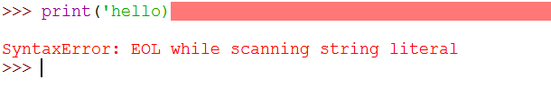
Syntax Errors
Errors due to violation of the language syntax
Python program with syntax error will not run.
E.g. missing end quote for string, missing: after if statement (in further topic)
Notes:
Syntax errors occur when code violates the language syntax. For example, when Python expects a close bracket but sees a letter instead, it will detect that the code is not legal Python code and freak out. In this example, the error is caused because after Python sees the print function followed by an open bracket and a single quote, it expects to eventually see another single quote that denotes the end of the string. However, in this case it reached the end of the line without seeing the other single quote, so it tells the programmer that there was a syntax error because it reached the end of line (which is what EOL stands for) while it is reading the string literal.
A program with a syntax error will not run. You MUST correct it, otherwise Python will just sit there, pout at you and do nothing. Thankfully, syntax errors are actually quite simple to correct. The IDE will show you both where the error occurred and what the error is, so just go to that line and correct it. As you practice more, you should be able to handle syntax errors relatively easily.

Slide 20
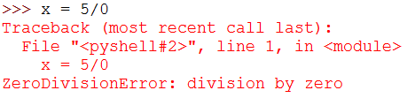
Runtime/Execution Errors
Errors that occur during running/execution of program.
Python program will run until code with error, then program will terminate with error msg.
Notes:
Assuming your program has no syntax errors, you may encounter errors when you are running the program. These are called runtime errors of execution errors. Essentially, although the program is syntactically correct, somewhere during execution the program encountered something that it cannot handle and crashes. In this example, even though this line does not violate Python syntax, it crashes because you can’t divide by zero. Other common runtime errors include using a variable before it is assigned with a value, trying to do an operation with a value of the wrong type, and trying to access the value outside the range of a list (more on lists later in this course).
Runtime errors can be tricky. Although the IDE does tell you which line caused the error and what the error was, it may not be immediately obvious what caused it. For example, even though you know it is a division by zero error, why was the denominator zero? Here’s where experience, logical thinking and some detective work will be useful. Start from line that caused the error and work backwards, and hopefully you will be able to track down the culprit.

Slide 21
Logic/Semantic Errors
Error occurs when the logic of the program is not written correctly
Program is able to run but output produced is incorrect.
E.g. wrong formula, forgetting precedence of operators in expression, wrong condition (in further topic)
Notes:
Finally, there are logic or semantic errors that occur when the logic of the program is not correct. You are able to run the program, it does not crash, but its behavior is different from what you expect. In a way, logic errors could be the hardest bugs to track down because Python does not tell you which line of code is the culprit. As far as Python is concerned, your program is working fine.
Logic errors may be caused by an error in formulating the model. It may also be the case that the model is correct, but the translation of the model into an algorithm is incorrect. Or it could be that the algorithm is correct, but implementing it into code was not done correctly. Because there are lots of possibilities, logic errors are pretty annoying.
However, all is not lost. As you gain experience and encounter more of these sorts of errors, you will get better at deducing what are the likely causes. Look at the thing that went wrong, figure out which parts of your code affect it, and start your debugging from there. Test out different inputs and see if you can spot any patterns.

Slide 22
Use Debugger to Solve Errors
It can be very difficult to figure out the bugs in your program
Programmers often make use of a Debugger, a program that allows
stepping through code line by line in same order of execution
showing what values are stored in variables each step
Use print statements to show the values stored in variables
Notes:
OK, real talk time. It is sometimes really difficult to debug your program. That’s why people pay programmers the big bucks – if it’s easy, everyone would be doing it. That being said, modern IDEs will offer debuggers, allows the programmer to step through their code line by line in the order of execution. At the same time, the debugger will show what values are stored in each variable in each step. In this way, you can slowly trace through your code and see when some variable is taking on some value that you do not expect.
IDLE does offer some debugging tools, but to be honest they are not very user-friendly. The debuggers in more modern IDEs like Visual Studio, PyCharm and Eclipse are much more user-friendly and powerful, but they are beyond the scope of this lesson. Instead, you have a really cheap and effective alternative to debuggers – the print statement. Use print to show the values of your variables at each part of your code, and this will serve a similar purpose to debuggers.

Slide 23
Activity Break!
Try to work on activities 7 & 8 now…
Remember to submit your solution to POLITEMall when you have completed all of them
Notes:
Music from https://www.fiftysounds.com/royalty-free-music/marseille.html

Slide 24
Programming Tips & Tricks
More haste less speed
Plan your program
Type carefully (spelling matters!)
Develop a consistent style
Easier to see inconsistencies at a glance
Do incremental coding
Stop to check your code every few lines
Make backups
Save different versions of your code when working on big programs
Notes:
We will end this lesson with some general tips and tricks that will help you make fewer errors in coding.
The first one is simple: more haste, less speed. There is a tendency for beginner programmers to just start programming immediately the moment they are presented with the problem. This is a recipe for trouble because if you have misunderstood the problem or not considered all the available solutions, you may be on the wrong track from the start. Instead, take some time to fully understand and analyze the problem before starting. Also, type carefully when you code because spelling matters.
Next, you should develop a consistent style. Start your variables with a lowercase letter, and make sure they have meaningful names. Decide if you prefer to add blank lines in between various parts of your code, whether to have a space after your commas, and so on. If you are consistent with your coding style, it actually makes it easier for you to see if you made some typographical error at a glance.
This is an important one: do incremental coding, which is the term to describe the practice of testing your program after only a few lines of code. There is a temptation for impatient programmers to just bash out 50 lines of code at once before testing it. The problem with doing that is that if there is an error, you will have at least 50 lines of code to look through to find the error. But if you find an error after only writing 5 lines of code, then the error was probably introduced in those 5 lines, making it a lot easier to debug.
Finally, one piece of practical advice is to make backups of your code, especially when you are working on a big program. Use “save as” to create different versions as you develop your program, in case you overwrite some of your old code when you are making changes. Better yet, back up your code in a different location, like a network drive or cloud storage, to guard against something catastrophic happening to your computer.

Slide 25
Summary
String Formatting
Program Errors and Debugging
Notes:
OK, that’s the end of today’s lesson. We covered string formatting, program errors and debugging. Not a bad day’s work, right?

Slide 26
Reading Reference
A Guide to the Newer Python String Format Techniques
https://realpython.com/python-formatted-output/
Python Programming/Errors
https://en.wikibooks.org/wiki/Python_Programming/Errors
POLITEMall – Problem Solving and Programming
https://politemall.polite.edu.sg/
Notes:
As usual, I leave you with some reading references in case you wish to supplement your knowledge about what we covered today. Until next time, happy coding!

